Slide 1


Attendance QR (Week 6, Session 2)

Slide 2
Meeting 6
STM32 Part Types and Sourcing
IEEE - CSULB Branch

Slide 3
Agenda
What is a PCB?
PCB Creation Process
Part Packages
Part Distributors
Demo: Schematic Creation

Slide 4
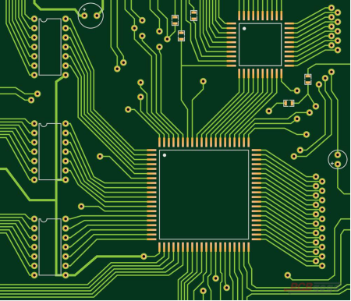
What is a PCB?
A printed circuit board (PCB) is a core component in electronics allowing for compact and reliable circuitry.
It is essentially an electronic assembly that uses copper conductors to create electrical connections between components soldered onto it.
PCBs are everywhere and range in complexity from LED strips, Key Fob computer motherboard, etc.

Slide 5
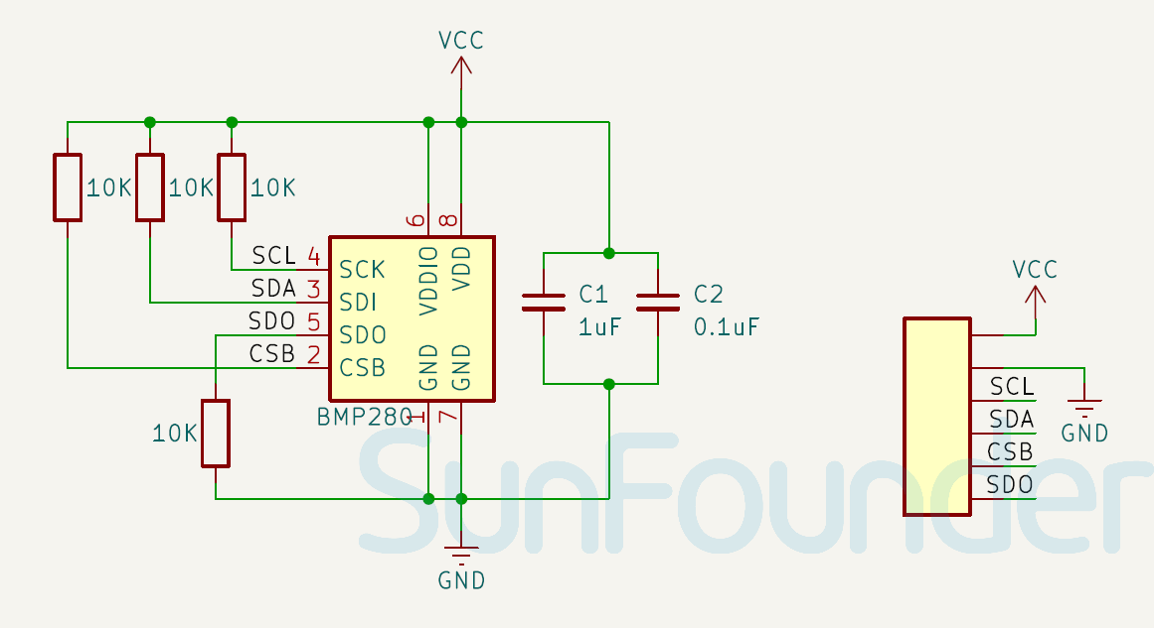
PCB Creation Process
Anyone can design and fabricate a finished PCB with components following steps:
Determine components needed and their electrical characteristics and compatibilities.
Design schematic(s) which are graphical representations of the electrical circuit.
Determines connections and parts needed using symbols and wire routing.

Slide 6
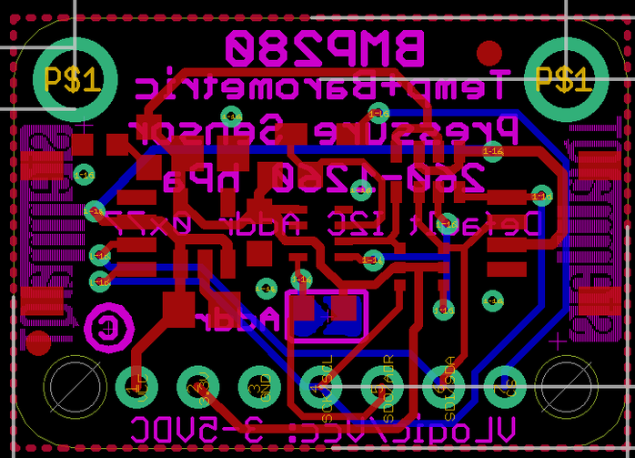
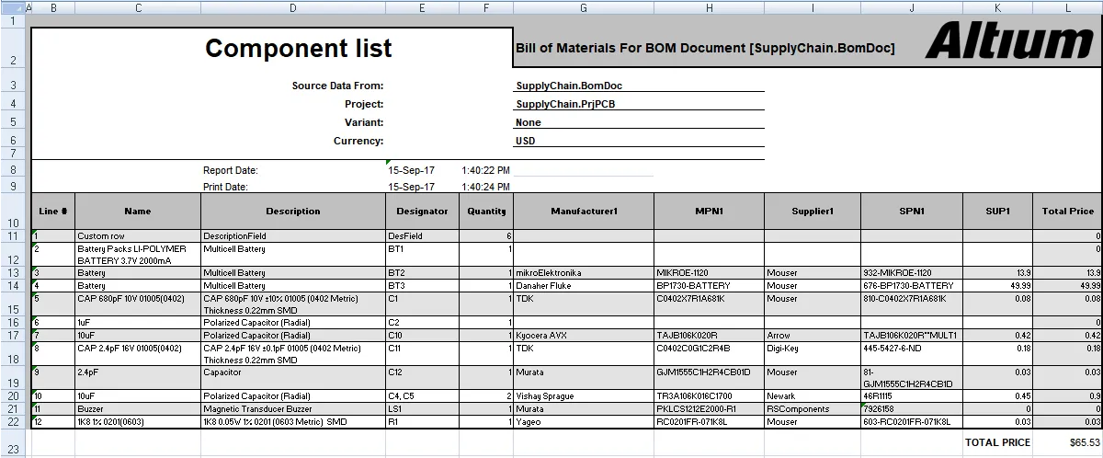
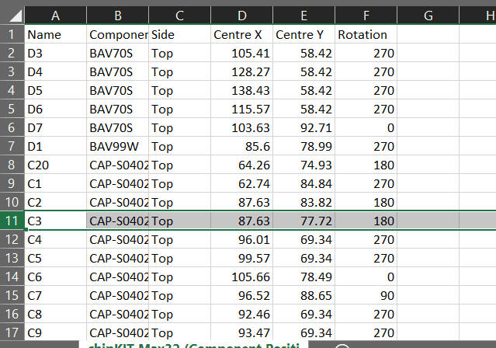
PCB Creation Process (cntd.)
Design PCB Layout which involves physical layout of the board copper routing, component pads, and layer formatting.
Prepare manufacturing/assembly files including:
Gerber files describe the physical design of the PCB and details about each layer.
Drill files define where holes are to be drilled.
Bill of materials (BOM) which lists component qualities and their quantities needed for assembly.
Pick and Place file gives “XY data” on where parts should be placed on the PCB.

Slide 7

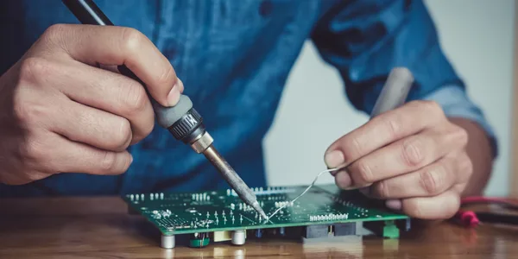
PCB Creation Process (cntd.)
After manufacturer constraints are taken into account, these files are used to fabricate the PCB.
PCB Manufacturer List
The PCB is assembled by a company or the user by soldering the parts to the board.
Now the board can be tested and used!

Slide 8
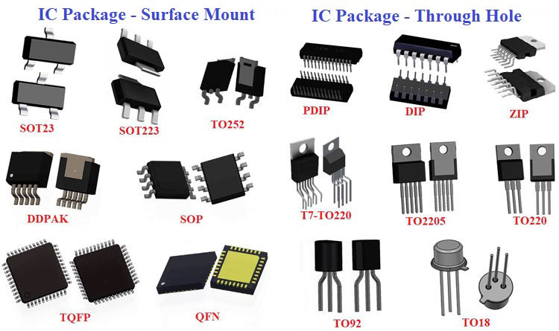
Part Packages
Through-hole goes through PCB layer(s).
More space/cost
Easier with soldering iron
Surface mount connects surface layer.
Smaller/more fragile
Easier with oven

Slide 9
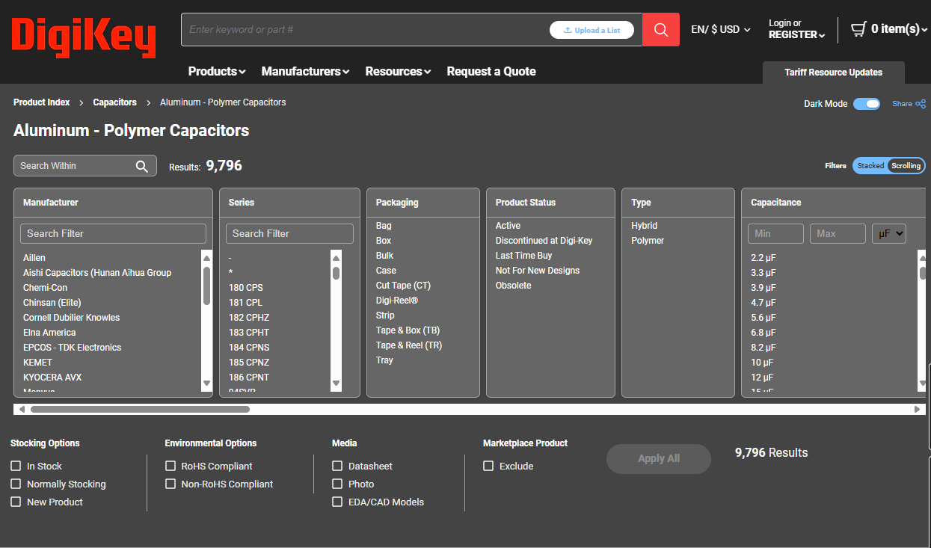
Part Distributors
Inventory availability, cost, shipping time, and quality assurance are all important factors when shopping for parts.
Distributors are all over the globe including ones like Digi-Key Electronics, Mouser Electronics, Adafruit Industries, etc.
DigiKey - Electronic Components Distributor

Slide 10
Demo: Schematic Creation
What is needed?
Software:
Altium Designer
Links:
Phil’s Lab Libraries
BMP280 Datasheet
AP2112 Datasheet

Slide 11
Join us next meeting for SPI Communication!
Please have Altium Designer for next week. Any Questions?

